Slide 1
Sr2RuO4 model information

Slide 2
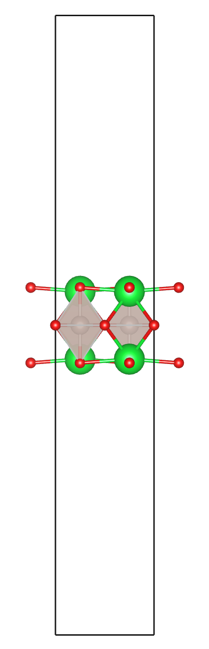
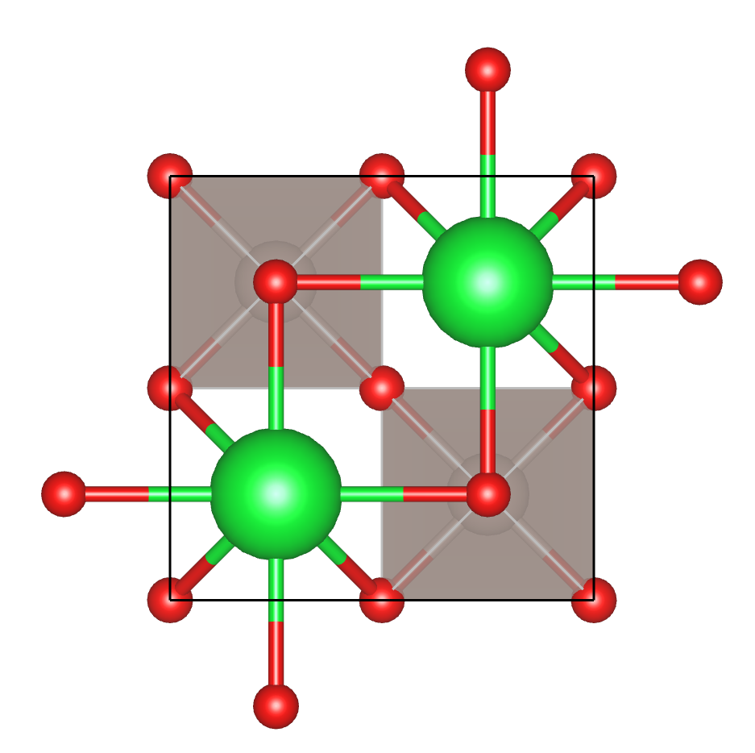
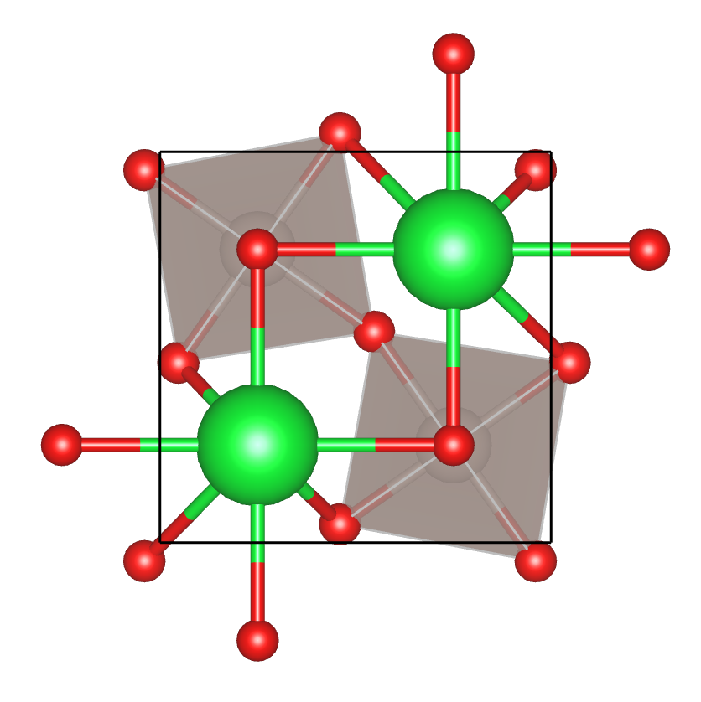
Models - Sr2RuO4_Xdeg.dat
Crystal structure is a monolayer of Sr2RuO4 with vacuum in a two Ru atom unit cell configuration.
Oxygen atoms rotated by X degrees centered around Ru atoms, clockwise for Ru atom 1, anticlockwise from Ru atom 2.
Ru-Ru distance were kept constant.
0 degrees
10 degrees

Slide 3
DFT info
Structural parameters taken from experimental .cif file.
- Vogt and Buttrey, PRB, 52,9843-9846 (1995)
Performed in Quantum Espresso, downfolded using Wannier90
PBE exchange correlation
k = 8x8x1, Ecutrho = 720 Ry, Ecutwfc = 90 Ry

Slide 4
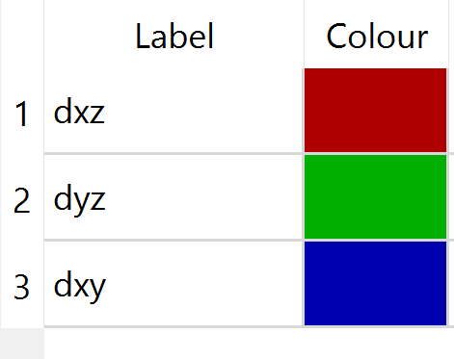
Electronic structure information
6 band model of the Ru dxz, dyz and dxy states for two Ru atoms.
The Wannier90 file has the orbitals labelled {dxz(Ru1),dyz(Ru1),dxy(Ru1),dxz(Ru2),dyz(Ru2),dxy(Ru2)}
Models with SOC have 12 states, the first 6 are in the same orbital order for the spin up states, the second 6 are equivalent for the spin down states. The SOC strength is 175 meV.
Band structures are coloured according to maximum orbital content

Slide 5
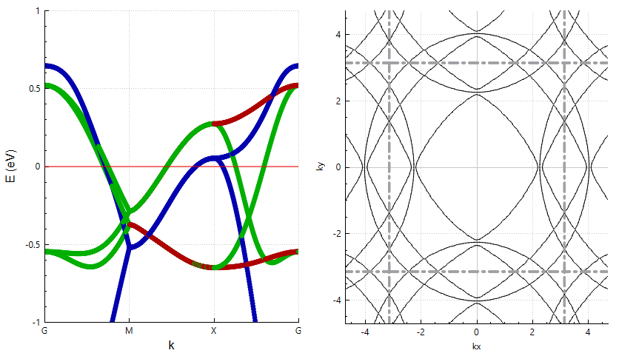
Sr2RuO4_0deg.dat

Slide 6
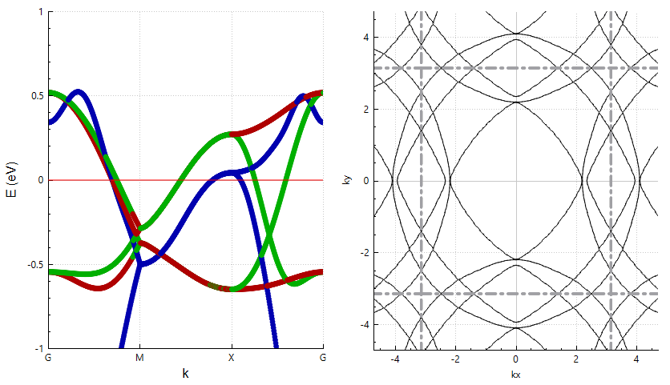
Sr2RuO4_1deg.dat

Slide 7
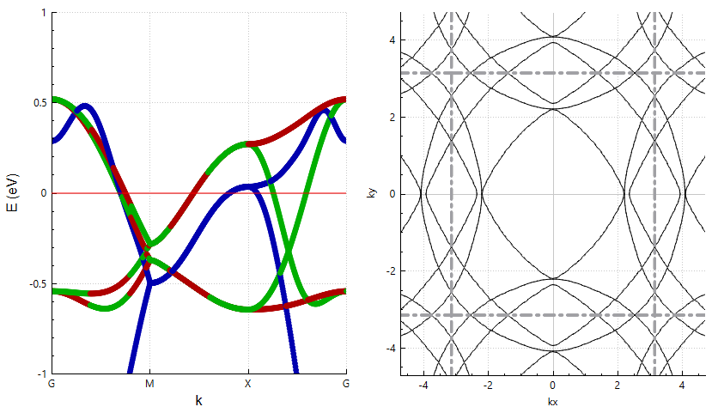
Sr2RuO4_2deg.dat

Slide 8
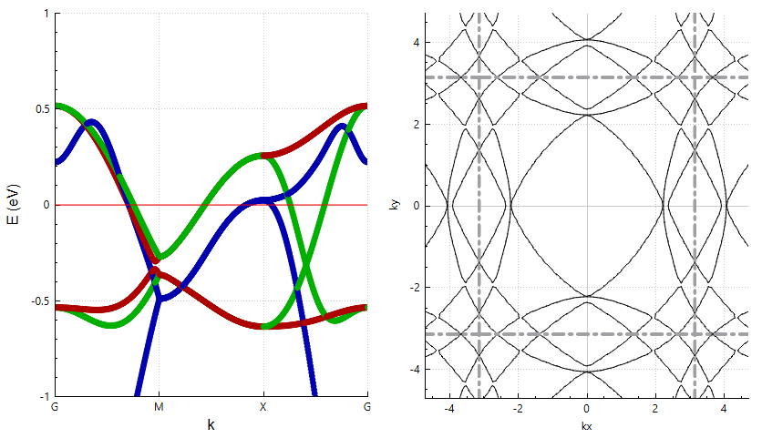
Sr2RuO4_3deg.dat

Slide 9
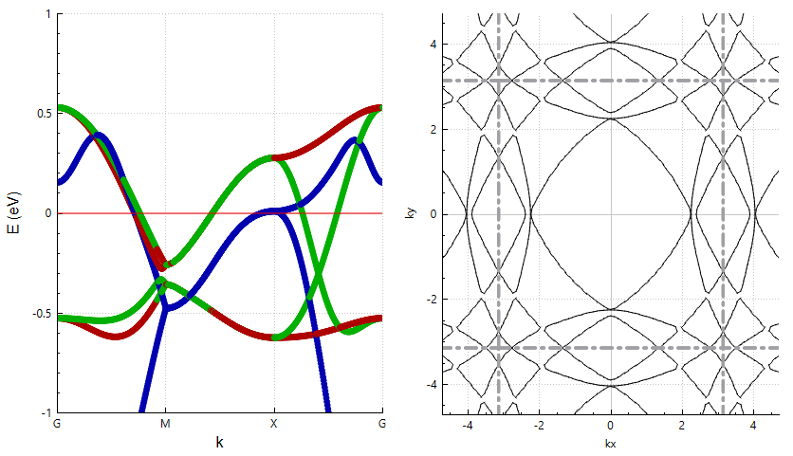
Sr2RuO4_4deg.dat

Slide 10
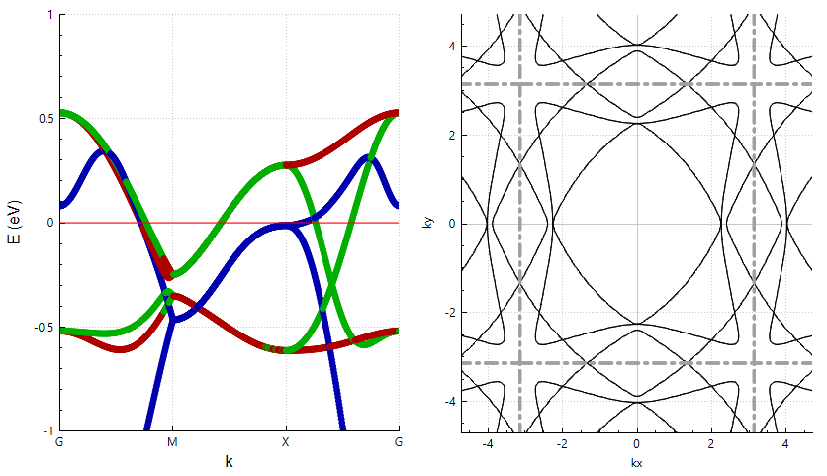
Sr2RuO4_5deg.dat

Slide 11
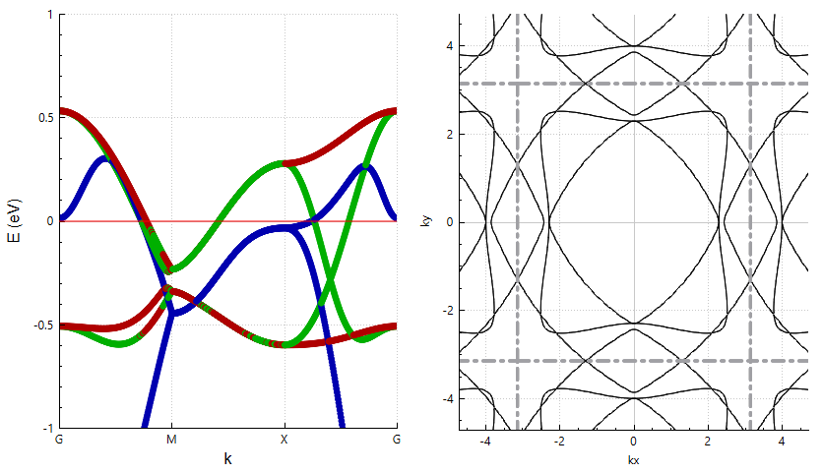
Sr2RuO4_6deg.dat

Slide 12
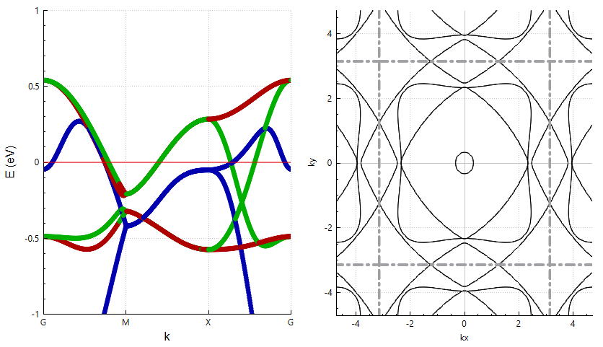
Sr2RuO4_7deg.dat

Slide 13
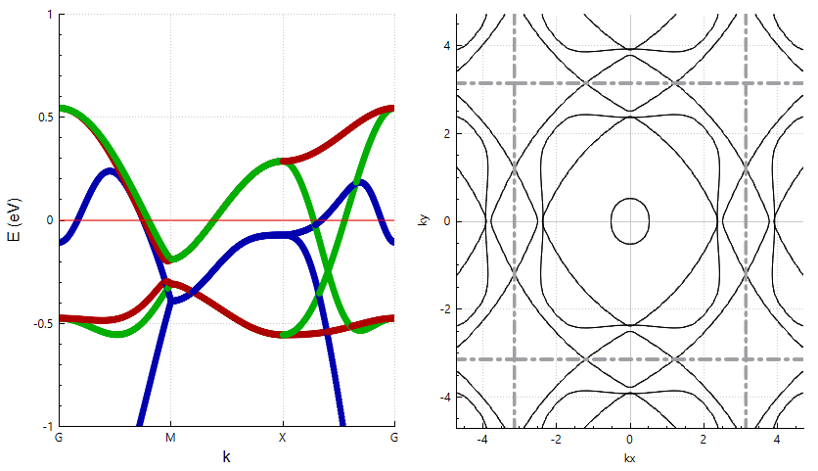
Sr2RuO4_8deg.dat

Slide 14
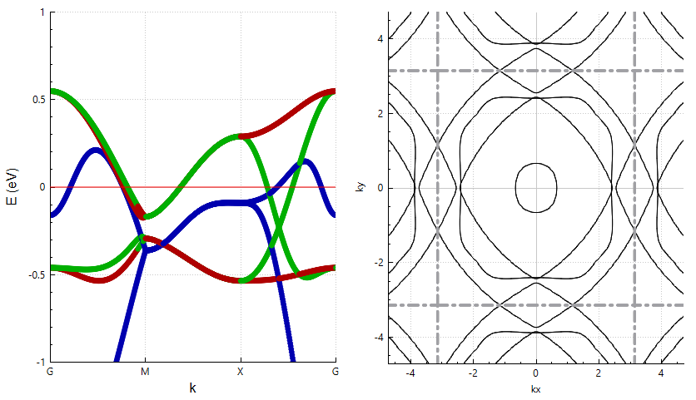
Sr2RuO4_9deg.dat

Slide 15
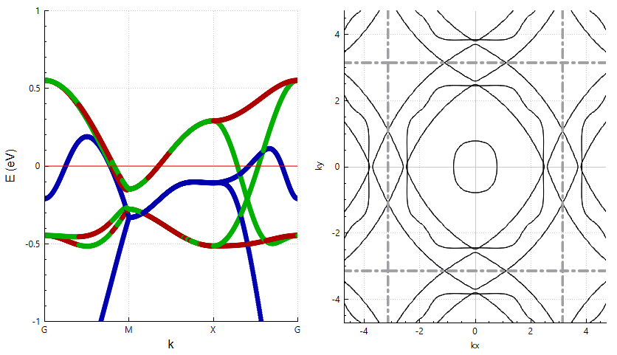
Sr2RuO4_10deg.dat

Slide 16
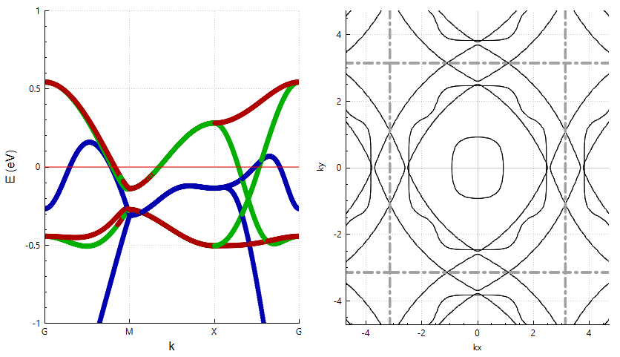
Sr2RuO4_11deg.dat

Slide 17
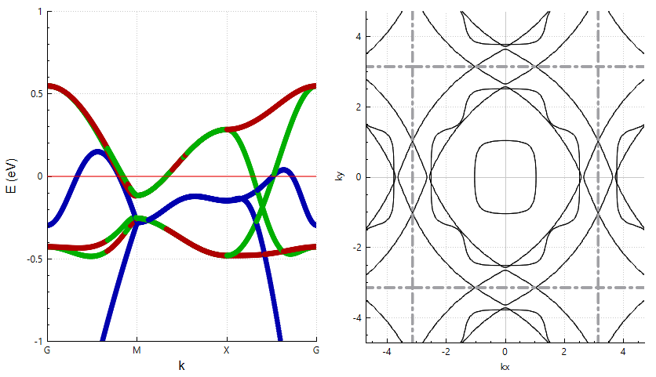
Sr2RuO4_12deg.dat

Slide 18
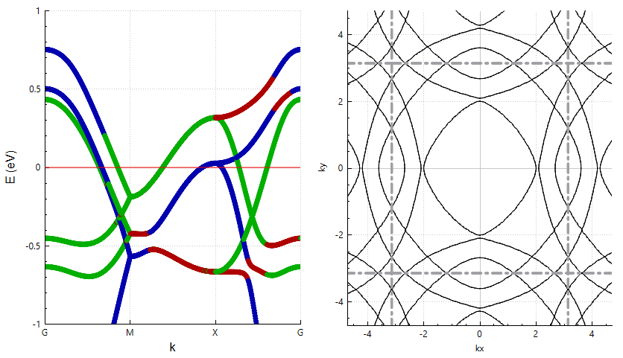
Sr2RuO4_0deg_SOC.dat

Slide 19
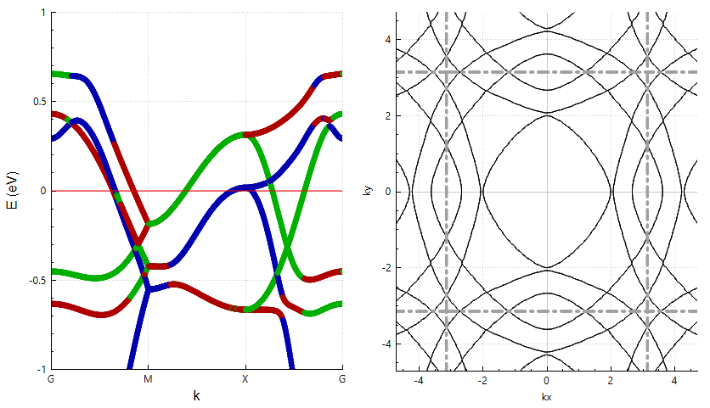
Sr2RuO4_1deg_SOC.dat

Slide 20
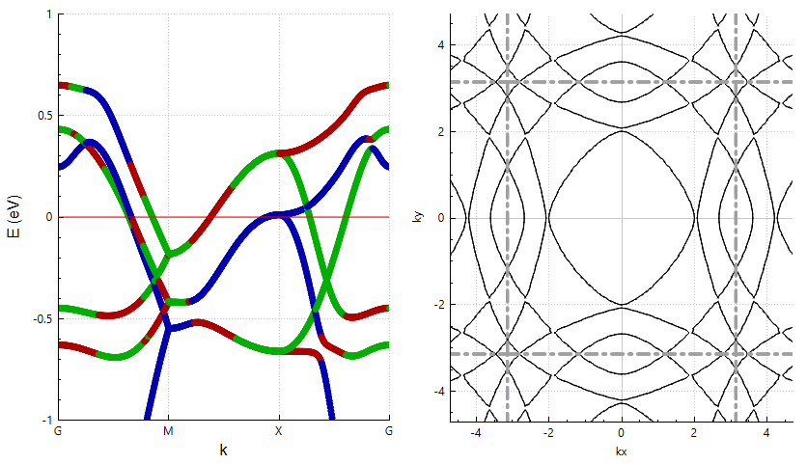
Sr2RuO4_2deg_SOC.dat

Slide 21
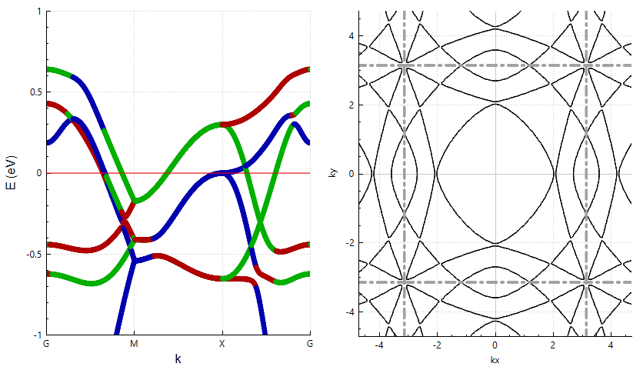
Sr2RuO4_3deg_SOC.dat

Slide 22
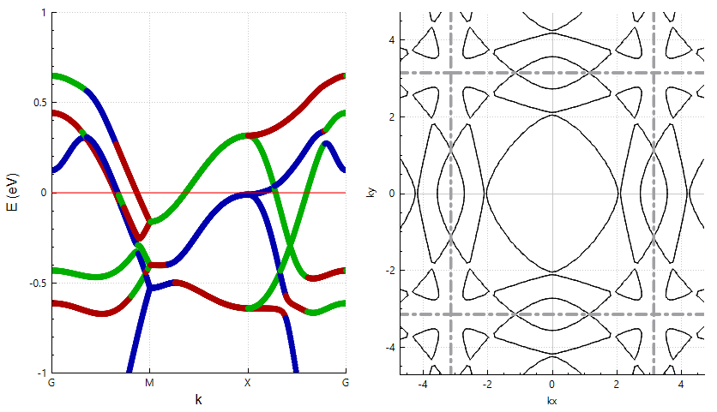
Sr2RuO4_4deg_SOC.dat

Slide 23
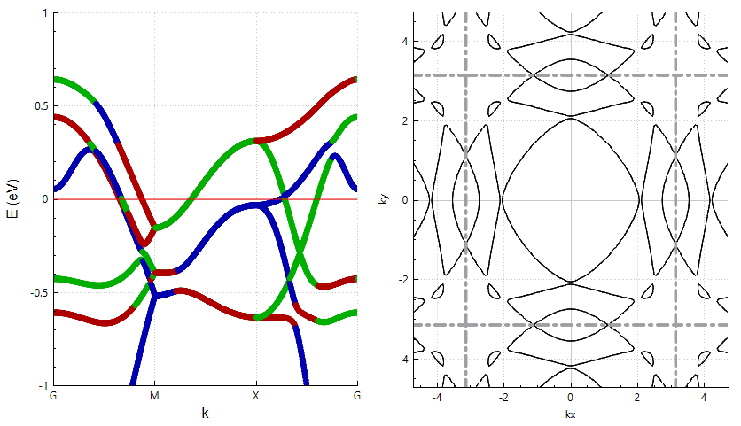
Sr2RuO4_5deg_SOC.dat

Slide 24
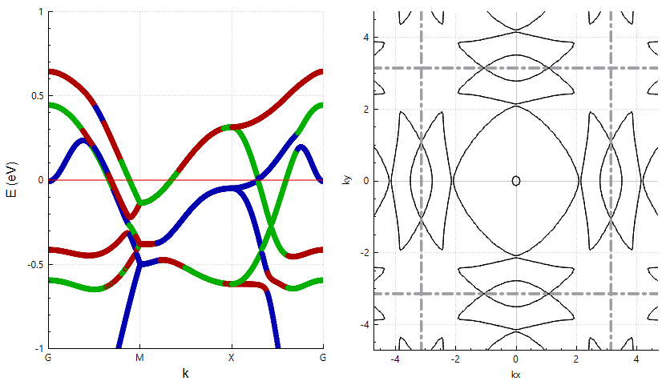
Sr2RuO4_6deg_SOC.dat

Slide 25
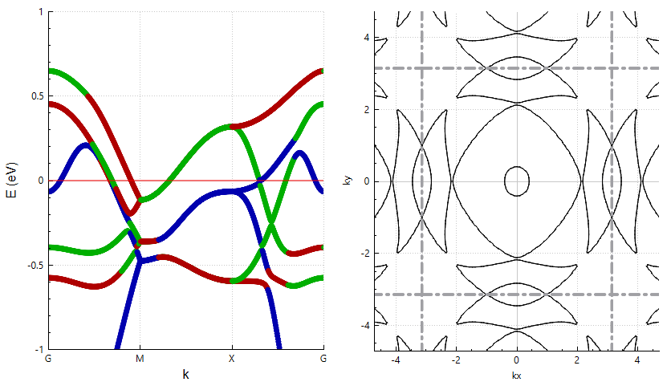
Sr2RuO4_7deg_SOC.dat

Slide 26
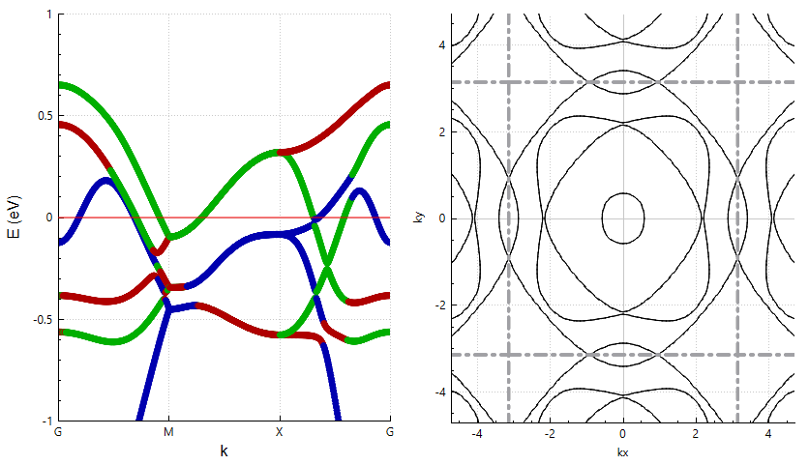
Sr2RuO4_8deg_SOC.dat

Slide 27
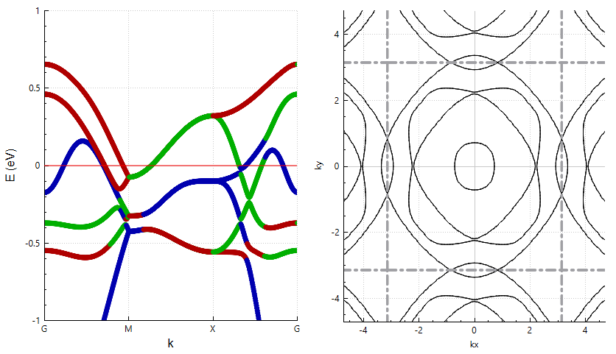
Sr2RuO4_9deg_SOC.dat

Slide 28
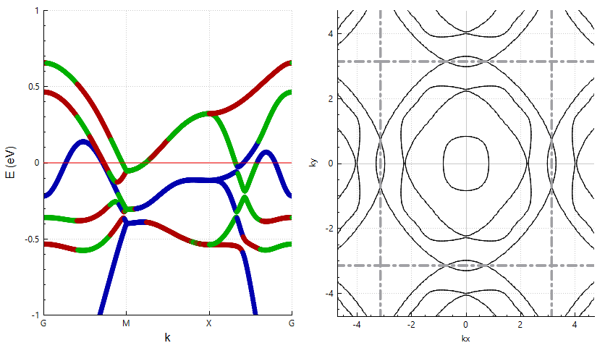
Sr2RuO4_10deg_SOC.dat

Slide 29
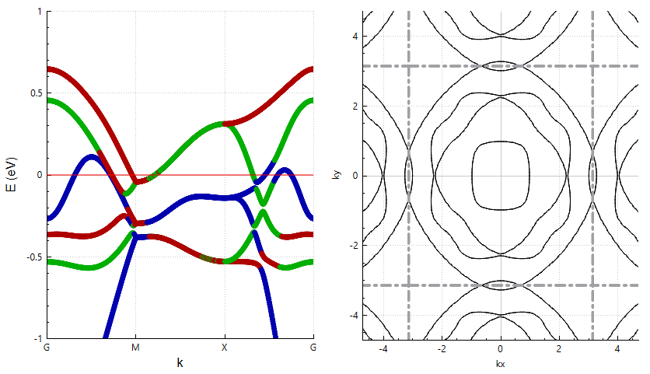
Sr2RuO4_11deg_SOC.dat

Slide 30
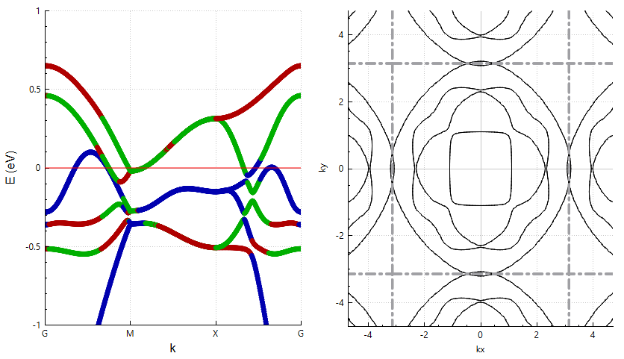
Sr2RuO4_12deg_SOC.dat

Slide 31
Sr2RuO4_12deg_SOC.dat

